Slide 1

Logistic Regression
What if we were to classify?

Slide 2
The Ask

Slide 3

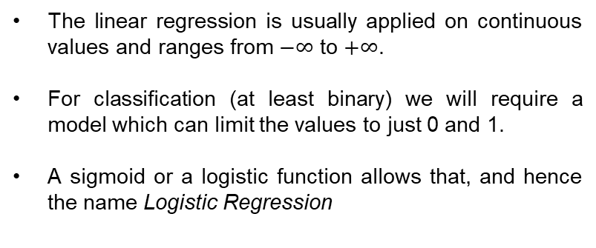
Why not Linear Regression?
The linear regression is usually applied on continuous values and ranges from $−∞$ to $+∞$.
For classification (at least binary) we will require a model which can limit the values to just 0 and 1.
A sigmoid or a logistic function allows that, and hence the name Logistic Regression
The line we need
Linear regression

Slide 4
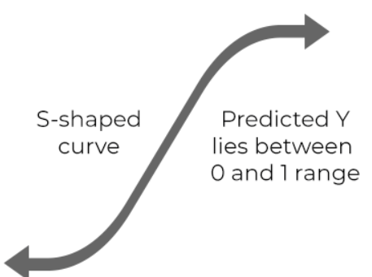
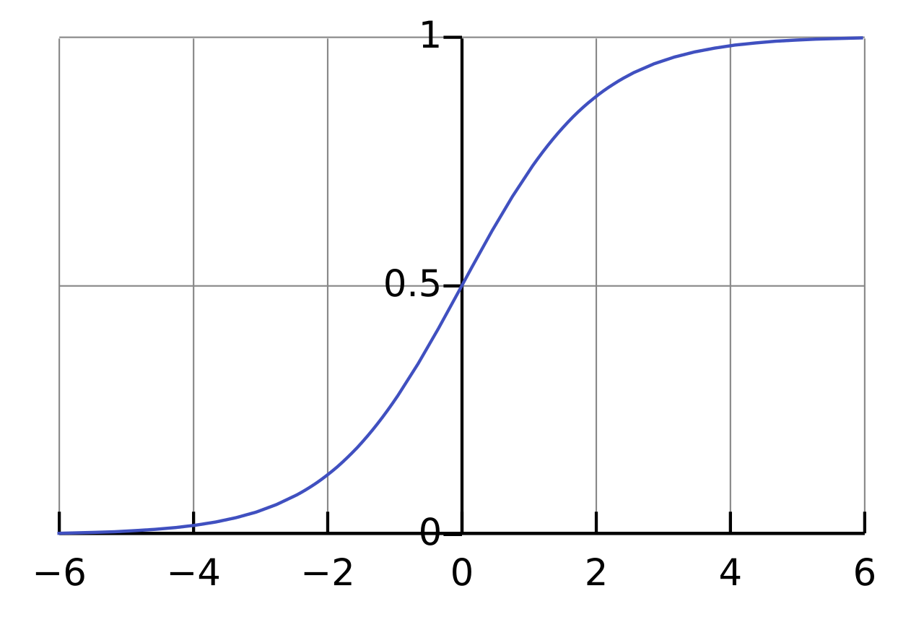
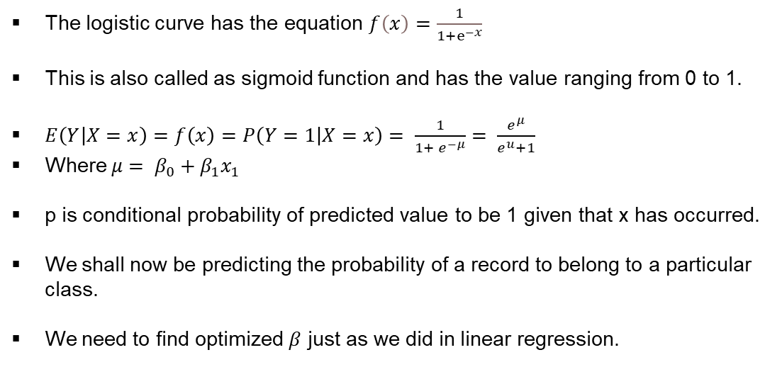
Logistic Model
The logistic curve has the equation $f\left(x\right)=\frac{1}{1+ⅇ^{−x}}$
This is also called as sigmoid function and has the value ranging from 0 to 1.
$E\left(Y | X=x\right)=f\left(x\right)=P\left(Y=1 | X=x\right)= \frac{1}{1+ e^{−μ}}= \frac{e^{μ}}{e^{u}+1}$
Where $μ= β_{0}+β_{1}x_{1}$
p is conditional probability of predicted value to be 1 given that x has occurred.
We shall now be predicting the probability of a record to belong to a particular class.
We need to find optimized $β$ just as we did in linear regression.
Logistic curve

Slide 5
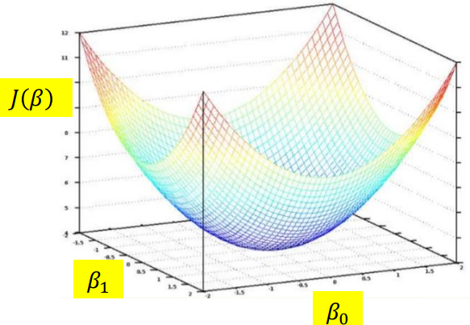

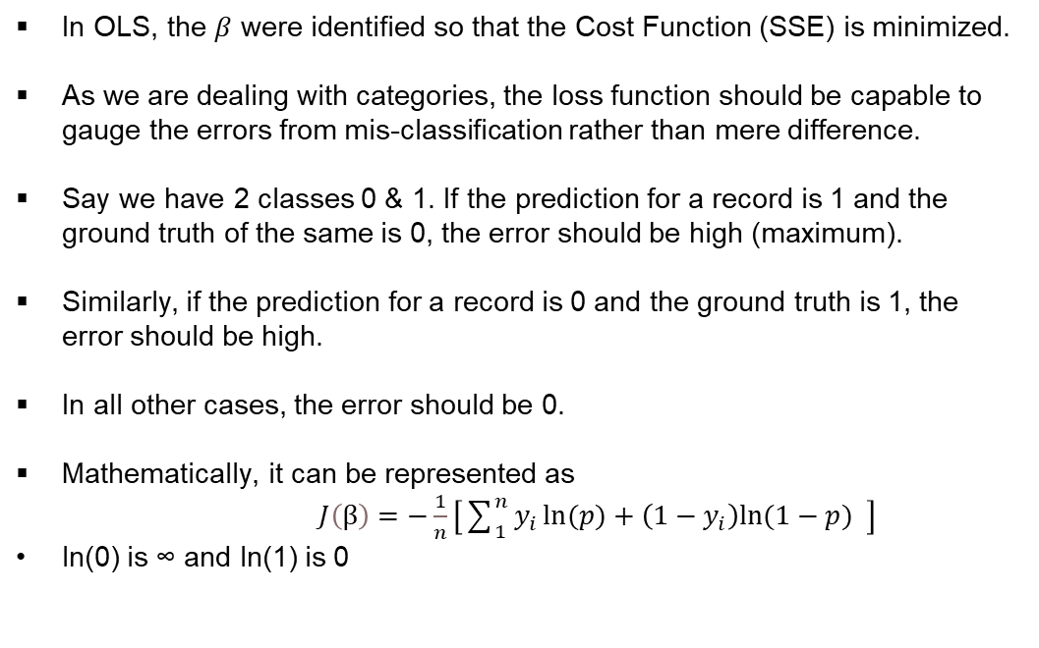


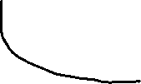

Cost/Loss Function
In OLS, the $β$ were identified so that the Cost Function (SSE) is minimized.
As we are dealing with categories, the loss function should be capable to gauge the errors from mis-classification rather than mere difference.
Say we have 2 classes 0 & 1. If the prediction for a record is 1 and the ground truth of the same is 0, the error should be high (maximum).
Similarly, if the prediction for a record is 0 and the ground truth is 1, the error should be high.
In all other cases, the error should be 0.
Mathematically, it can be represented as
$J\left(β\right)=−\frac{1}{n}\left[\sum_{1}^{n}{y_{i}\ln{(p)}+\left(1−y_{i}\right)ln⁡(1−p)} \right]$
ln(0) is ∞ and ln(1) is 0
Credits: https://www.slideshare.net/ocampesato/d3-typescript-and-deep-learning
$y_{i}$=1, p=0
$$J\left(β\right)$$
$$0$$
$$1$$
$y_{i}$=0, p=1
$$J\left(β\right)$$
$$0$$
$$p$$
$$1$$

Slide 6
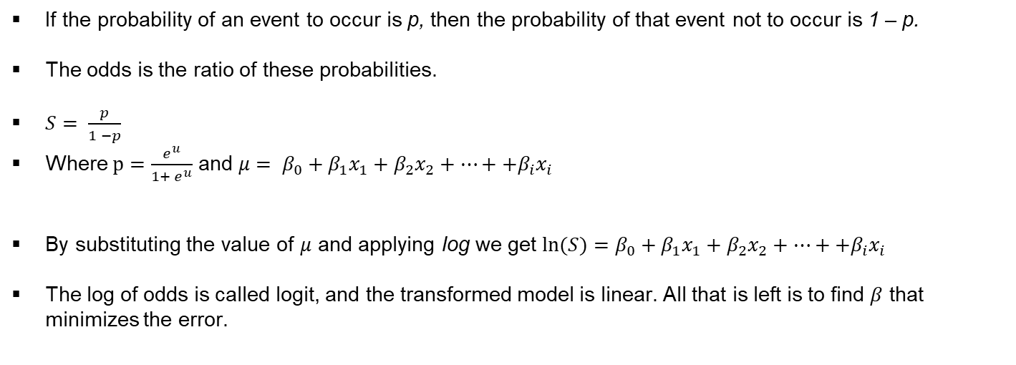
Odds Ratio
If the probability of an event to occur is p, then the probability of that event not to occur is 1 – p.
The odds is the ratio of these probabilities.
$S= \frac{p}{1 −p}$
Where $p=$ $\frac{e^{u}}{{1+ e}^{u}}$ and $μ= β_{0}+β_{1}x_{1}+β_{2}x_{2}+…++β_{i}x_{i}$
By substituting the value of $μ$ and applying log we get $ln⁡(S)=β_{0}+β_{1}x_{1}+β_{2}x_{2}+…++β_{i}x_{i}$
The log of odds is called logit, and the transformed model is linear. All that is left is to find $β$ that minimizes the error.

Slide 7
Logistic Regression
The output of logistic regression is probabilities of an event belonging to a class/label.
If we use a probability of 0.50 as a cutoff between predicting a class 0 or class 1, any value above 0.5 would belong to class 1 and vice-versa.
The log of odds is a linear model and we can stick to previous learnings around multi-collinearity, AIC, VIF etc.,
As we speak about this linear model that is derived. This is actually the hyper plane which is the decision boundary for each class.
Linear model

Slide 8
How good is Classification?
Confusion Matrix:
 |  | Predicted
 |  | Positive (Class 1) | Negative (Class 0)
Actual | Positive (Class 1) | True +ve | False –ve(II) | Recall/Sensitivity/TPR (Minimize False –ve)
 | Negative (Class 0) | False +ve (I) | True -ve | Specificity/TNR (Minimize False +ve)
 | Precision |  |  | Harmonic mean (F1 Score)
Refer: https://www.evidentlyai.com/classification-metrics/confusion-matrix

Slide 9
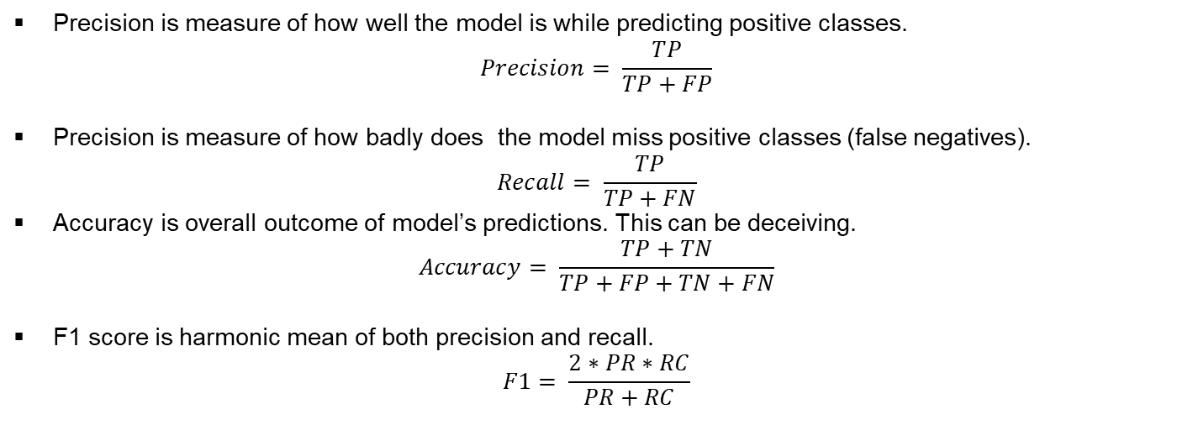
Precision Recall & F1 Score
Precision is measure of how well the model is while predicting positive classes.
$$Precision= \frac{TP}{TP+FP}$$
Precision is measure of how badly does the model miss positive classes (false negatives).
$$Recall= \frac{TP}{TP+FN}$$
Accuracy is overall outcome of model’s predictions. This can be deceiving.
$$Accuracy= \frac{TP+TN}{TP+FP+TN+FN}$$
F1 score is harmonic mean of both precision and recall.
$$F1= \frac{2∗PR∗RC}{PR+RC}$$

Slide 10
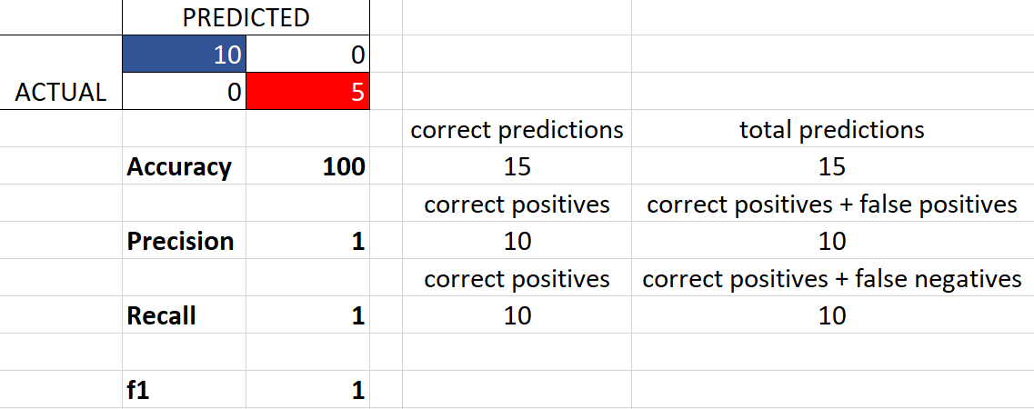

Let us visualize it.

Slide 11
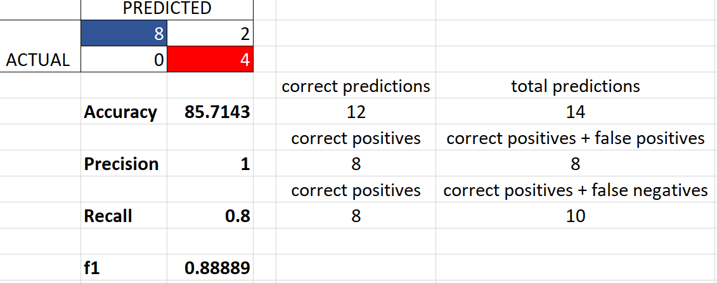
Let us visualize Precision.
Model wrongly classified these as Negative.
When I say it is positive, am pretty sure the actual is positive too. I may wrongly classify positives as negatives.

Slide 12
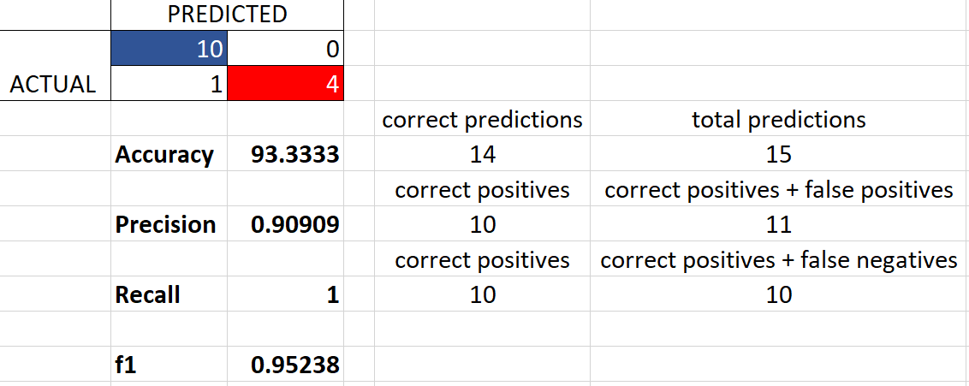
Let us visualize Recall.
Model wrongly classified this as positive.
When I say it is negative, am pretty sure the actual is negative too. I may wrongly classify negatives as positives.

Slide 13
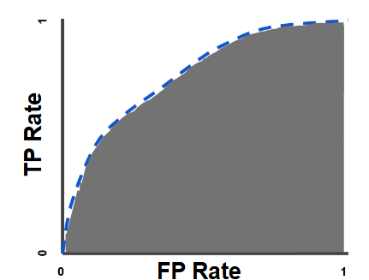
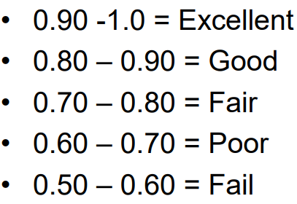
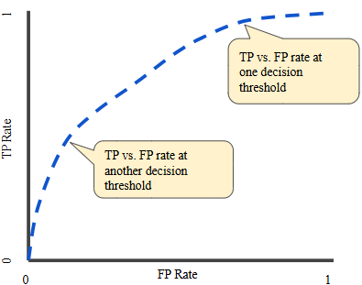
ROC & AUC
Once the predictions are made, how to increase precision/recall ?
ROC – Receiver operating characteristic.
AUC – Area under curve. To what extension is the classification good?
Ref: Classification: ROC Curve and AUC | Machine Learning | Google for Developers

